Slide 1

Network Attacks and Crimes
Dr. Iftikhar Alam
Associate Professor

Slide 2
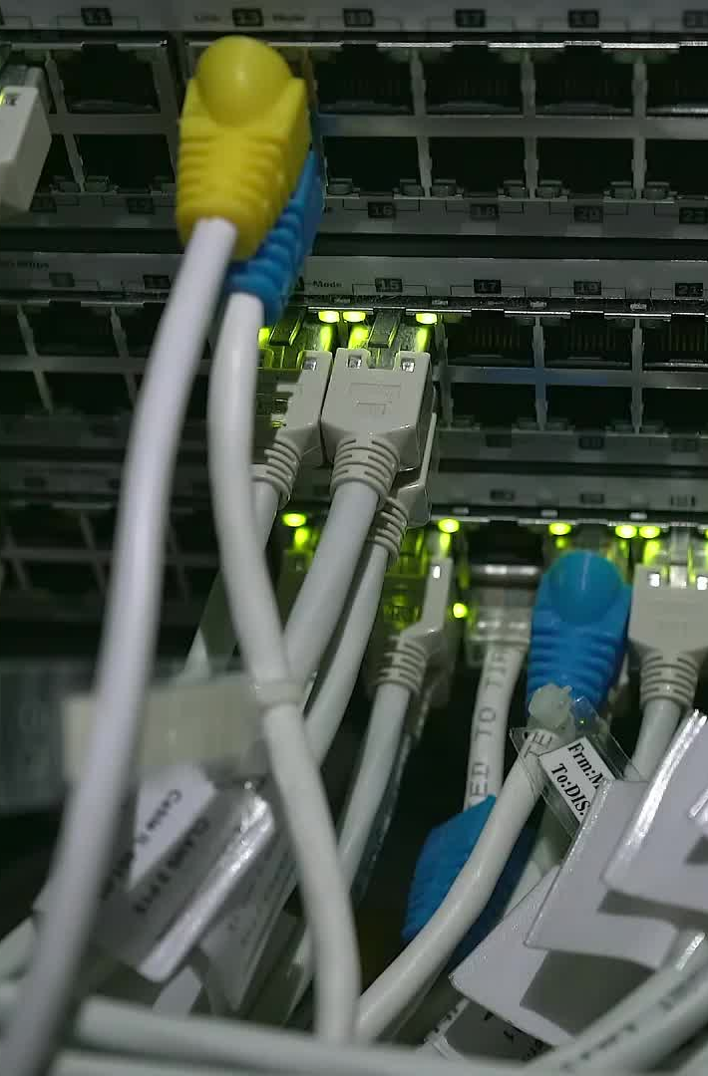
Some basic terminologies
Networking
Layers
Encryption/Decryption
IP address
Hub, switch, routers

Slide 3

Cont…
Media (Guided/unguided)
Data Transfer (KBPS. MBPS)
Client server architecture
Some popular server OS

Slide 4
Network attacks
Intrusion
DOS/DDOS
DOS
Flooding attacks
Sending large number of messages/requests
To saturate the network bandwidth of the target machine or a node involved in the network path to the victim.
DDOS
A distributed attack involving at least 10 agents would lead a DoS on the victim.

Slide 5
Email attacks
Phishing
Spyware
Spams

Slide 6
Spoofing attacks (man-in-the-middle)
IP Address Spoofing
In an IP spoofing attack, an attacker will send IP packets from a spoofed IP address to hide their true identity. Attackers most often use IP address spoofing attacks in DoS attacks that overwhelm their target with network traffic. In such an attack, a malicious actor will use a spoofed IP address to send packets to multiple network recipients.

Slide 7
Cont…
Caller ID spoofing
Spoofing attacks can also arrive as phone calls. In a caller ID spoofing attack, a scammer makes it appear as if their call is coming from a number the victim knows and trusts or, alternatively, a number that is associated with a specific geographic location.

Slide 8
Cont…
Email address spoofing attacks
Email spoofing involves sending emails using false sender addresses. Attackers often use email address spoofing in socially engineered phishing attacks hoping to deceive their victims into believing an email is legitimate by pretending that it came from a trusted source.

Slide 9
Cont…
Website spoofing attacks
In a website spoofing attack, a scammer will attempt to make a malicious website look exactly like a legitimate one that the victim knows and trusts. Website spoofing is often associated with phishing attacks. When a victim clicks on a link in a phishing email, the link may take them to a website that looks just like a site they use

Slide 10
Cont…
DNS server spoofing attacks
Domain Name System (DNS) resolves domain names to IP addresses. When conducting a DNS spoofing attack, an attacker attempts to introduce corrupt DNS cache information to a host in order to impersonate that host’s domain name.

Slide 11
SQL injection
Unmoderated user data inputs could place organizational networks at risk of SQL injection attacks. Under the network attack method, external parties manipulate forms by submitting malicious codes in place of expected data values. They compromise the network and access sensitive data such as user passwords.
There are various SQL injection types, such as examining databases to retrieve details on their version and structure and subverting logic on the application layer, disrupting its logic sequences and function.

Slide 12
Unauthorized Access
Hacking/cracking
Password theft etc.
Already discussed

Slide 13
Sinkhole
Sinkhole is a service attack that prevents the base station from obtaining complete and correct information. In this attack, a node tries to attract the data to it from his all neighbouring node.
Selective modification, forwarding or dropping of data can be done by using this attack.

Slide 14
Sybil
This attack related to the multiple copies of malicious nodes. The Sybil attack can be happen due to malicious node shares its sec ret key with other malicious nodes. In this way the number of malicious node is increased in the network and the probability of the attack is also increases. If we use d the multipath routing, then the possibility of selecting a path malicious node will be increased in the network

Slide 15
Eavesdropping
This is a passive attack, which occurred in the mobile ad-hoc network. The main aim of this attack is to find out some secret or confidential information from communication.
This secrete information may be privet or public key of sender or receiver or any secrete data.

Slide 16
Firewalls
A Firewall is a network security device that monitors and filters incoming and outgoing network traffic based on an organization's previously established security policies. At its most basic, a firewall is essentially the barrier that sits between a private internal network and the public Internet.

Slide 17
Types of firewalls
Proxy firewall
An early type of firewall device, a proxy firewall serves as the gateway from one network to another for a specific application. Proxy servers can provide additional functionality such as content caching and security by preventing direct connections from outside the network.
Stateful inspection firewall
A stateful inspection firewall allows or blocks traffic based on state, port, and protocol.
Unified threat management (UTM) firewall
A UTM device typically combines, in a loosely coupled way, the functions of a stateful inspection firewall with intrusion prevention and antivirus.

Slide 18
Cont…
Next-generation firewall (NGFW)
Firewalls have evolved beyond simple packet filtering and stateful inspection. Most companies are deploying next-generation firewalls to block modern threats such as advanced malware and application-layer attacks
Integrated intrusion prevention system (IPS)
Application awareness and control to see and block risky apps
Upgrade paths to include future information feeds
Techniques to address evolving security threats
URL filtering based on geolocation and reputation

Slide 19
End of lecture

